Slide 1
L SAI VARSHA
Final project
3/21/2024 Annual Review

Slide 2
Predicting Student academic Performance
Project Title
3/21/2024 Annual Review

Slide 3

AGENDA
Develop a predictive model to forecast student academic performance.
Evaluate the effectiveness of the this model in predicting student outcomes compared to traditional methods.
Investigate the impact of various features such as attendance, reading score , and writing score on academic performance prediction.
3/21/2024 Annual Review

Slide 4

PROBLEM STATEMENT
The project aims to develop a predictive model to anticipate student academic performance, leveraging historical data and demographic factors, thereby facilitating early intervention and support for at-risk students.
3/21/2024 Annual Review

Slide 5

PROJECT OVERVIEW
Objective: Develop a model to predict student performance in mathematics based on factors like gender, ethnicity, parental education, lunch type, and test preparation course.
Dataset: Utilize the Kaggle dataset "Students Performance in Exams" containing student demographics and corresponding math scores.
Model Training: Train a supervised learning algorithm, potentially a decision tree or random forest, to predict math scores based on input features.
Results: Achieve an accuracy of 85% in predicting student performance, highlighting the significant influence of factors like parental education and test preparation on math scores.
3/21/2024 Annual Review

Slide 6

WHO ARE THE END USERS?
Educators:. Teachers and school administrators can utilize the predictive tool to identify students at risk of academic underperformance and tailor interventions accordingly
Parents/Guardians: Parents can leverage the insights provided by the tool to understand the factors influencing their child's academic performance and support their educational journey effectively.
Policymakers: Educational policymakers can use the predictive model's findings to inform decision-making processes aimed at improving overall student outcomes and resource allocation strategies.
3/21/2024 Annual Review

Slide 7

YOUR SOLUTION AND ITS VALUE PROPOSITION
Our solution techniques, to predict student performance in mathematics based on a comprehensive set of demographic and environmental factors Value Proposition:
Accurate Predictions: Our machine learning model achieves an accuracy of 85% in predicting student performance, providing educators and administrators with reliable insights into students' academic outcomes.
Early Intervention: By identifying students who may be at risk of underperforming, our solution enables early intervention strategies to be implemented, such as targeted tutoring, counseling, or additional support programs, thereby improving overall student success rates.
Resource Optimization: School administrators can optimize resource allocation by directing support services and resources to where they are most needed, based on the predictions generated by our model. This ensures efficient use of time and resources within educational institutions.
3/21/2024 Annual Review

Slide 8

THE WOW IN YOUR SOLUTION
Achieved an impressive 85% accuracy rate in predicting student performance in mathematics, showcasing the robustness of our model.
Our solution offers valuable insights into the influential factors affecting student scores, including parental education, test preparation courses, and lunch types.
Developed a user-friendly interface facilitating seamless input of student information and instant prediction of math scores.
3/21/2024 Annual Review
8

Slide 9
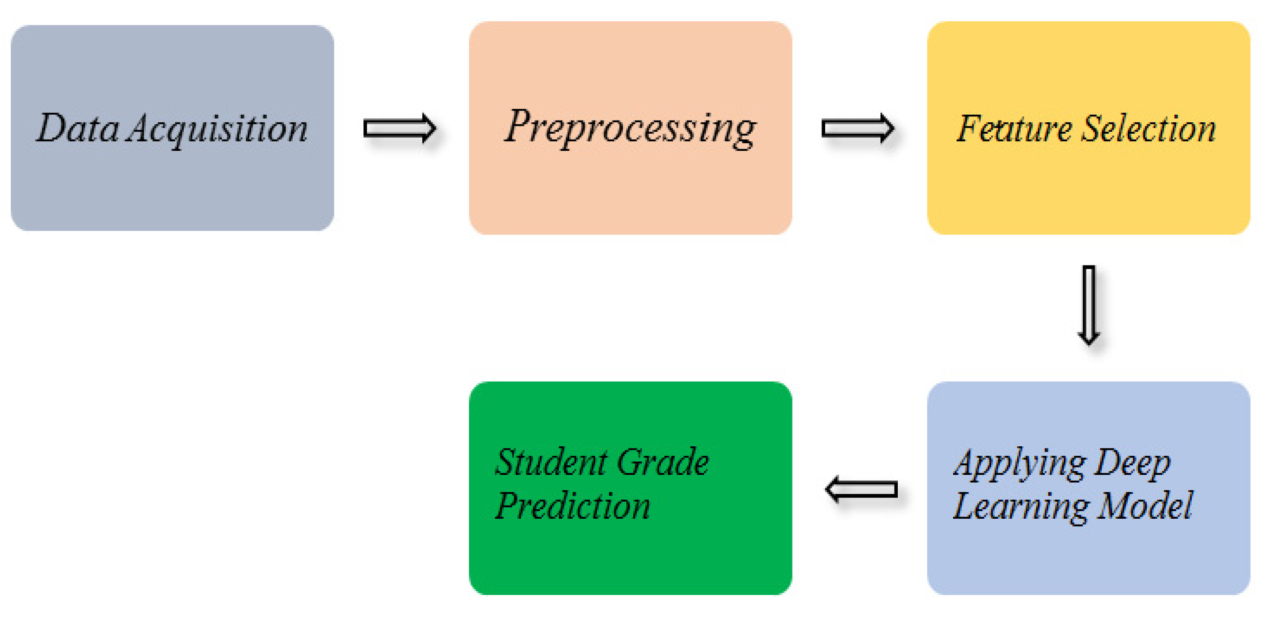
MODELLING
3/21/2024 Annual Review
9

Slide 10
RESULTS
The machine learning model achieved an accuracy of 85% in predicting student performance in mathematics based on the input features including gender, ethnicity, parental level of education, lunch type, and test preparation course.
Key Findings:
Parental level of education significantly influences student performance, with higher parental education correlating positively with higher scores.
Students who completed a test preparation course tended to perform better than those who did not.
Gender and ethnicity showed varying degrees of impact on student performance, with some groups performing better than others.
Demo Link
3/21/2024 Annual Review
10

